Slide 1
Biomechanical Response of Human Skin: A Hierarchical Porous Media Framework.
Thomas Lavigne
Supervisors: S. Bordas, P-Y. Rohan, G. Sciumè Jury and guests: C. Vincenot, S. Avril, Y. Payan, S. Budday, S. Laporte
AFR-FNR 17013182
Notes:
10 seconds
Good afternoon, everyone. My name is Thomas Lavigne, and I'm here today to present my work on the Biomechanical Response of Human Skin, specifically through the lens of a Hierarchical Porous Media Framework.

Slide 2

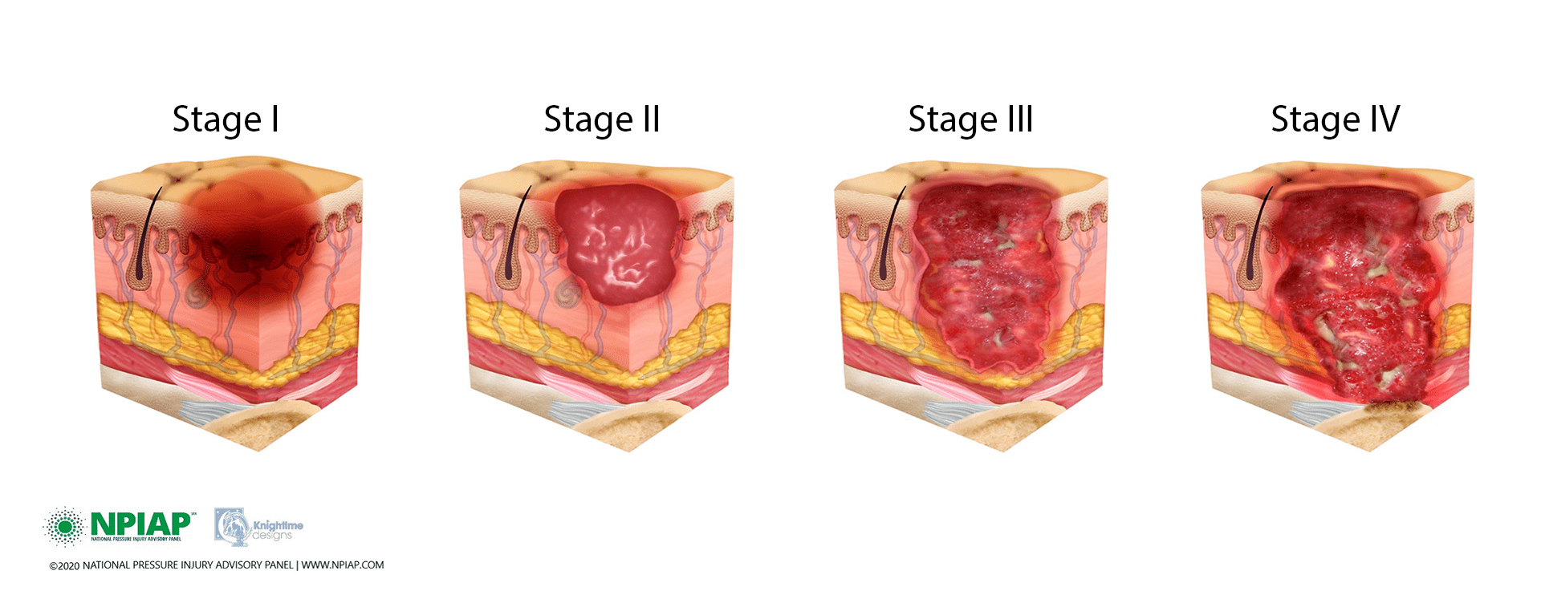













Pressure ulcers
[Vanderwee et al., 2007]
[Ayello 2008; Parvizi et al. 2023]
€€€€€€
[Padula and Delarmente 2019]
Notes:
30 seconds
"That problem is Pressure Ulcers, commonly known as bedsores. As you can see by the progression from Stage I to Stage IV, these are not minor injuries—they are complex wounds caused by prolonged pressure, often combined with friction and shear."
"The scale of this issue is significant. Pressure ulcers are a major burden globally, affecting millions of patients in hospitals and long-term care facilities (1/5 in Europe and almost ½ worldwide).” Critically, from an economic standpoint, they are considered a 'Never Event' but their treatment costs are astronomical, often exceeding per patient for advanced cases. They drain resources that could be used for preventative care.“
"Fundamentally, this condition is preventable, but it requires a deeper understanding of the biomechanical limits of the human body."
Pressure ulcers (PUs) typically fall just below the top tier of the most expensive chronic diseases. In fact, some sources from that period stated that pressure ulcers were the third most costly disease after cancers and cardiovascular diseases.
Key Takeaway
While the total annual cost of PUs is massive, it is dwarfed by the spending on major, population-wide chronic conditions like heart disease, cancer, and diabetes.
However, PUs are notable for two reasons:
They are considered a "Never Event": The costs are largely for complications that are deemed preventable, making the $9.1–$11.6 billion a highly scrutinized and often unreimbursed expense for hospitals since 2008.
Per-Case Cost is Astronomical: The individual cost to treat a single advanced pressure ulcer can range from $20,900 to over $150,000, making them incredibly costly on a per-patient basis.¹

Slide 3


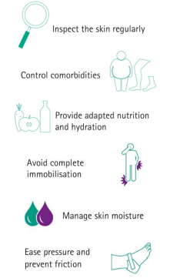

Clinical reality
Notes:
15 seconds "In the clinical setting, prevention protocols are well-established. They focus on maintaining the integrity of the skin and tissue. We instruct caregivers to: Inspect the skin regularly, control comorbidities like diabetes, provide adapted nutrition and hydration, and, most crucially, manage mechanical forces by ensuring the patient is turned regularly to relieve pressure."
"However, despite these protocols, the prevalence remains high. This tells us there is a gap between our preventative practice and the underlying biological and physical mechanisms.”

Slide 4
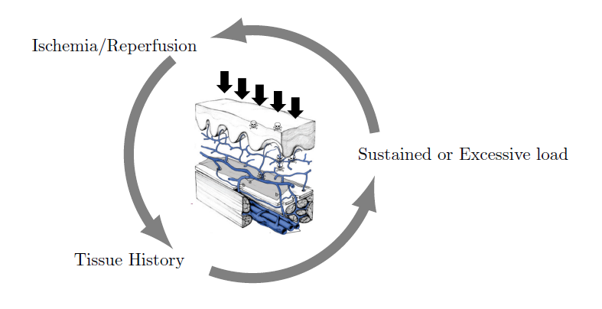
Clinical research
Biology (oxygen supply)
External (sustained) forces
History of the tissue
Notes:
Research into PU etiology has revealed several tangible quantitative risk factors, including biological factors like oxygen deprivation, sustained external mechanical loads, and the overall condition (or history) of the tissue.

Slide 5
Clinical research: interplay ?
Biology (oxygen supply)
External (sustained) forces
History of the tissue
Notes:
However, these factors are still generally studied separately, despite the fact that they significantly influence one another.

Slide 6
A skin porous model compared to patient data: a comprehensive tool for understanding the bidirectional link between mechanical integrity and microvascular health.
Notes:
To close this gap, my research proposes a porous model of the skin, compared to patient data, as a comprehensive tool for understanding the bidirectional link between mechanical integrity and microvascular health.

Slide 7
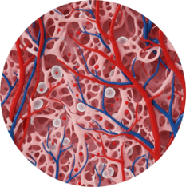
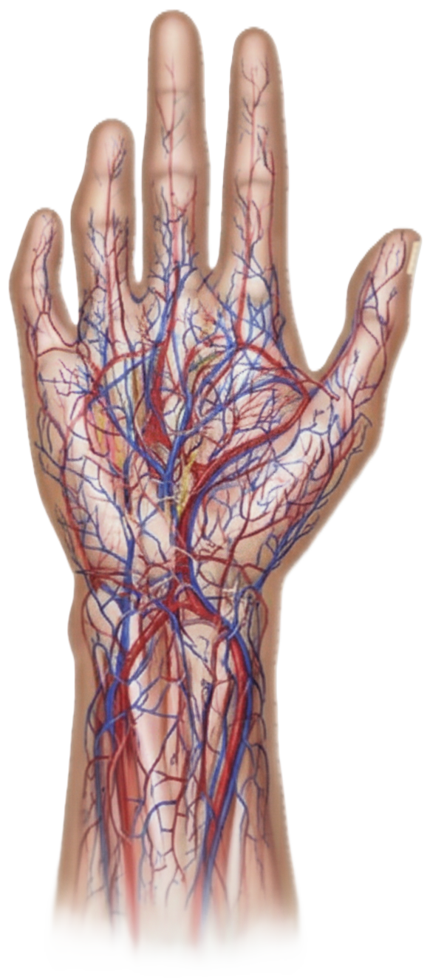



The Human skin as a sponge
The Barrier with the environment:
[Burns et al., 2010]
Some images are AI generated
Notes:
5 sec The skin is the outermost layer of our body and protects us as a barrier with the environment, ensuring load bearing, healing, and thermoregulation.

Slide 8
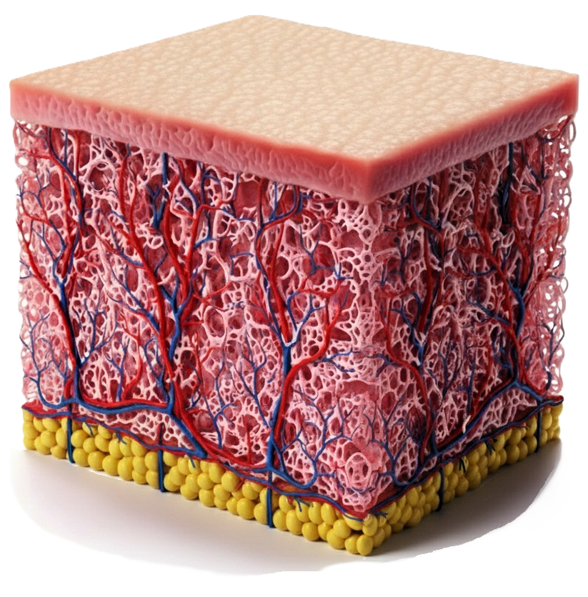
The Human skin as a sponge
Macroscale:
Stratified
Fibrous
60% of water
[Burns et al., 2010]
Some images are AI generated
Notes:
Looking closer, the skin is a stratified tissue, including the epidermis and the dermis. Critically, it is composed of almost 60% of water. Therefore, we can think of it as a sponge with an external impermeable layer.

Slide 9
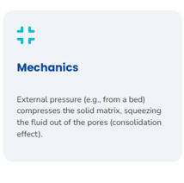
The Human skin as a sponge
Mechanics
An escessive stress leads to the loss of integrity of the skin
Macroscale:
Stratified
Fibrous
60% of water
[Burns et al., 2010]
Some images are AI generated
Notes:
At this scale, a mechanically-driven collapse or loss of integrity can occur in the presence of excessive stress.

Slide 10
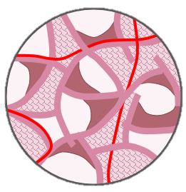
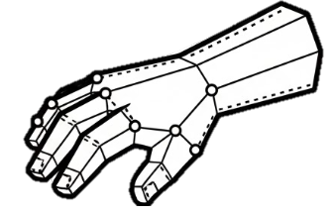
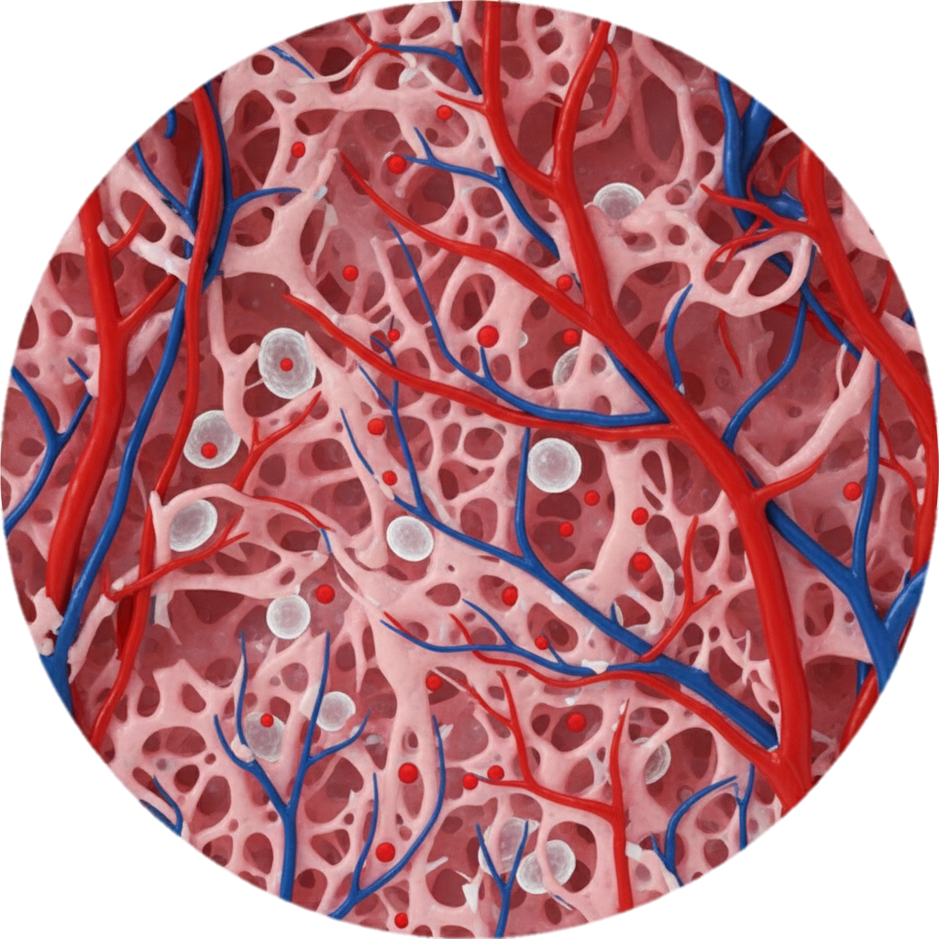
The Human skin as a sponge
Mesoscale = Model equations
F(x)
Some images are AI generated
Notes:
If we zoom in a bit further, we’ll have a representative element, ‘brick’, of our skin. This is what we call the representative elementary volume and that serves as the basis of the model.

Slide 11
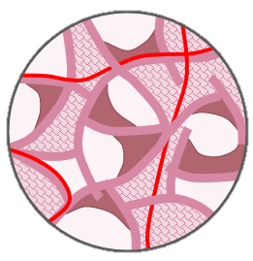
The Human skin as a sponge
Microscale : biology scale
Interstitial fluid
Mobile cells
Structural cells and other structures
Connective tissue
Micro-vascular system = oxygen supply
Some images are AI generated
Notes:
Finally, zooming even more, we’ll reach the biological scale where the different fluids, cells, blood vessels and structural tissue coexist.

Slide 12
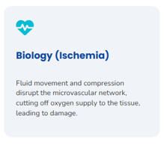
The Human skin as a sponge
Biology
Fluid movement and compression disrupt the microvascular network, cutting off oxygen supply to the tissue, leading to damage.
Microscale : biology scale
Interstitial fluid
Mobile cells
Structural cells and other structures
Connective tissue
Micro-vascular system = oxygen supply
Some images are AI generated
Notes:
At this scale, The fluid movement and compression transmitted from the macroscopic scale disrupt the microvascular network, cutting off oxygen supply to the tissue, leading to damage. But how to model the skin as a sponge ?

Slide 13
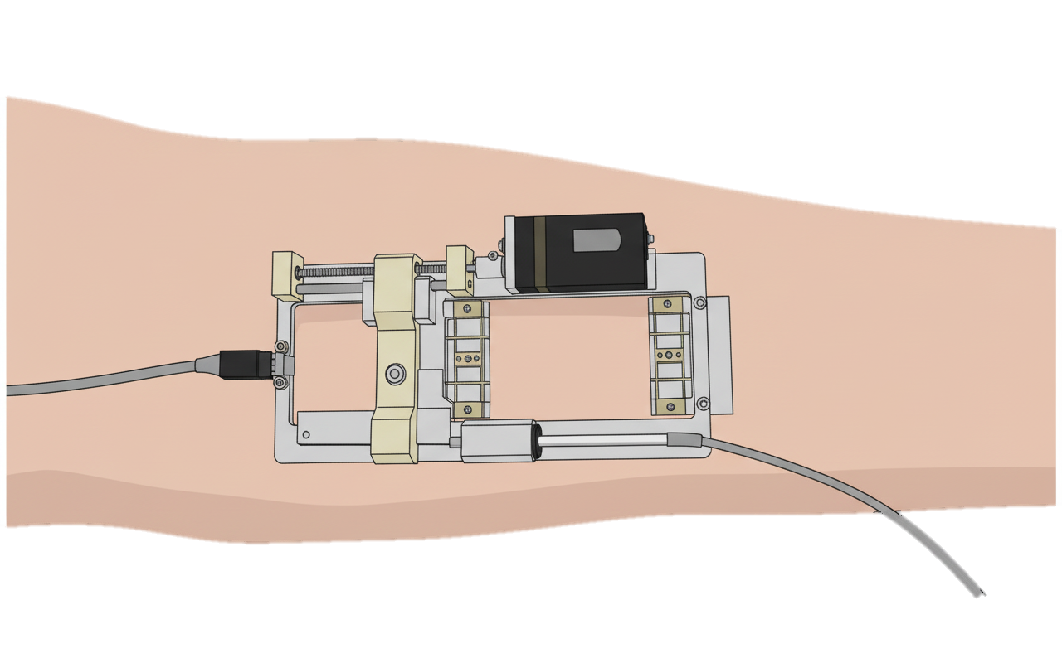
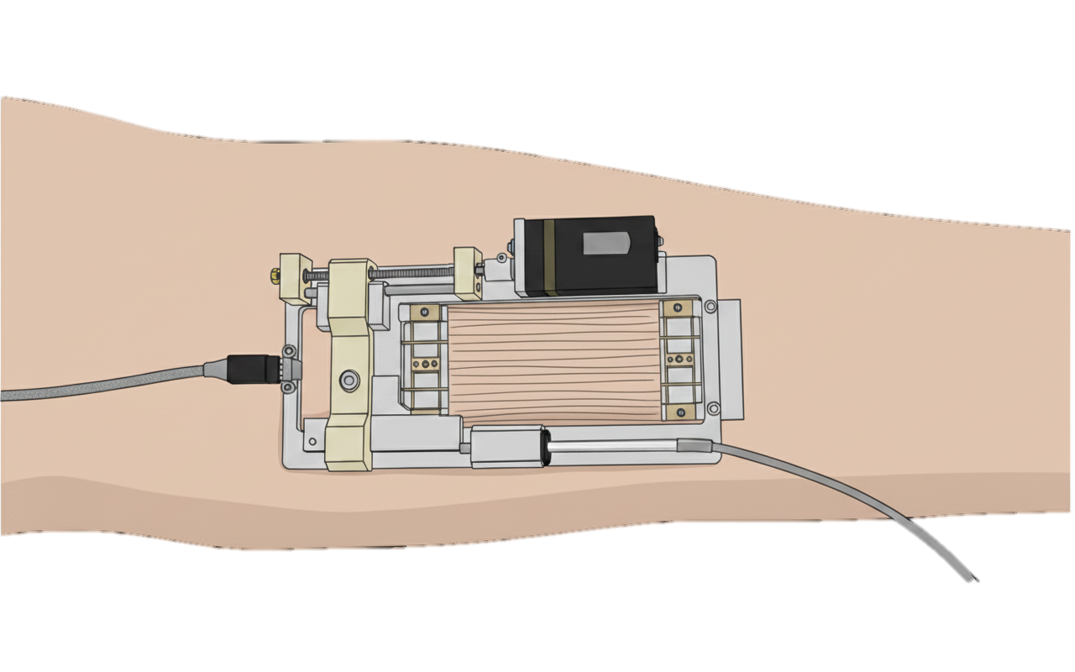
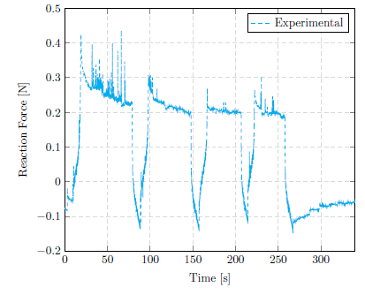




The Porous (bricks) Model
Preliminary study:
Conservation Laws
Constitutive Laws
Mass Conservation
Solid
Stress-Strain law
Solid
IF
F(x, p^{α}) =
Force Equilibrium
Total stress
Darcy IF
Some images are AI generated
Notes:
To represent the skin as a porous medium we followed an iterative approach systematically compared to patient data. two types of equations are used: first, the well-established conservation laws of mechanics, which govern force equilibrium and mass conservation ; and second, the constitutive laws, where we introduce our specific hypotheses to model the interaction between the different phases. Let’s first add the solid, and the fluid in the pores. Before increasing the complexity, we tested the model on an extension test on arm skin. During the experiment, the amount of force generated by the skin as a reaction to the imposed displacement was monitored

Slide 14
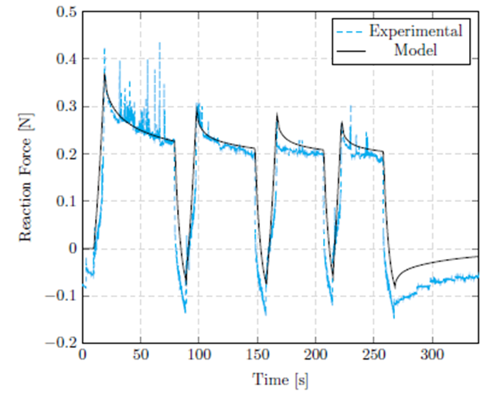
The Porous (bricks) Model
Preliminary study:
Conservation Laws
Constitutive Laws
Mass Conservation
Solid
Stress-Strain law
Solid
IF
F(x, p^{α}) =
Force Equilibrium
Total stress
Darcy IF
Some images are AI generated
Notes:
And the Model was well capable to reproduce this experiment, even with that simplistic composition

Slide 15

The Porous (bricks) Model
Conservation Laws
Constitutive Laws
Mass Conservation
Solid
Stress-Strain law
How does it work?
Increasing force on the solid
Increased pressure in the pores
Squeezed blood vessels
Solid
Cells
Oxygen
Interstitium
IF
Blood
IF pressure / Cell Saturation
F(x, p^{α}) =
Force Equilibrium
Vascular phase
Porosity
Permeability
Total stress
Darcy Blood
Oxygen
Darcy IF
Darcy Cells
Diff. Oxygen
Abs. Oxygen
Notes:
Then we can add more and more phases, now the pores are filled with a mixture of cells and fluid, the vascular network is added as an inmiscible phase, and oxygen diffusion betwen the phases could be introduce. But how does it work ? WWWWW The state of mind of the model being set, it was once again compared to an experiment, but this time, a new one designed for this specific purpose of evaluation

Slide 16
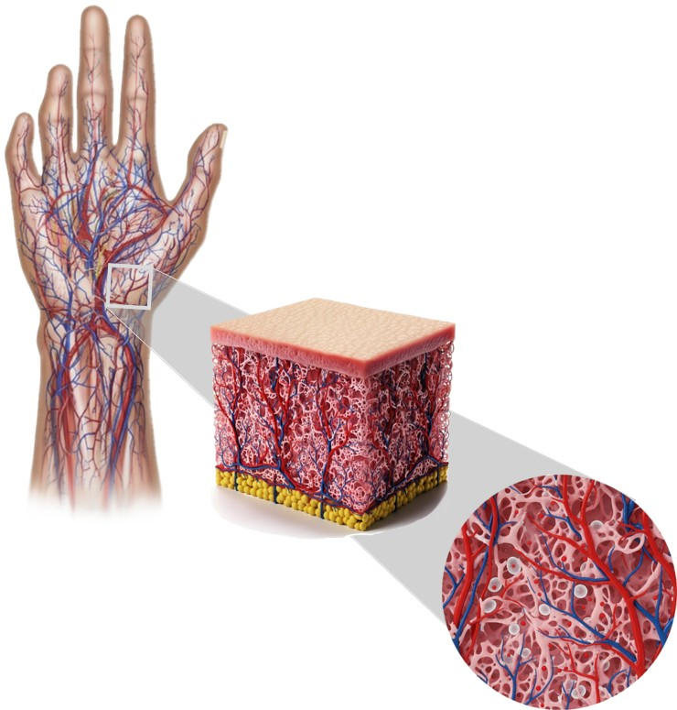
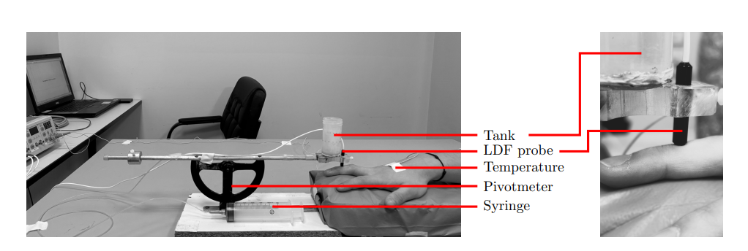
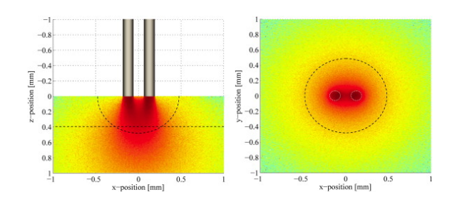
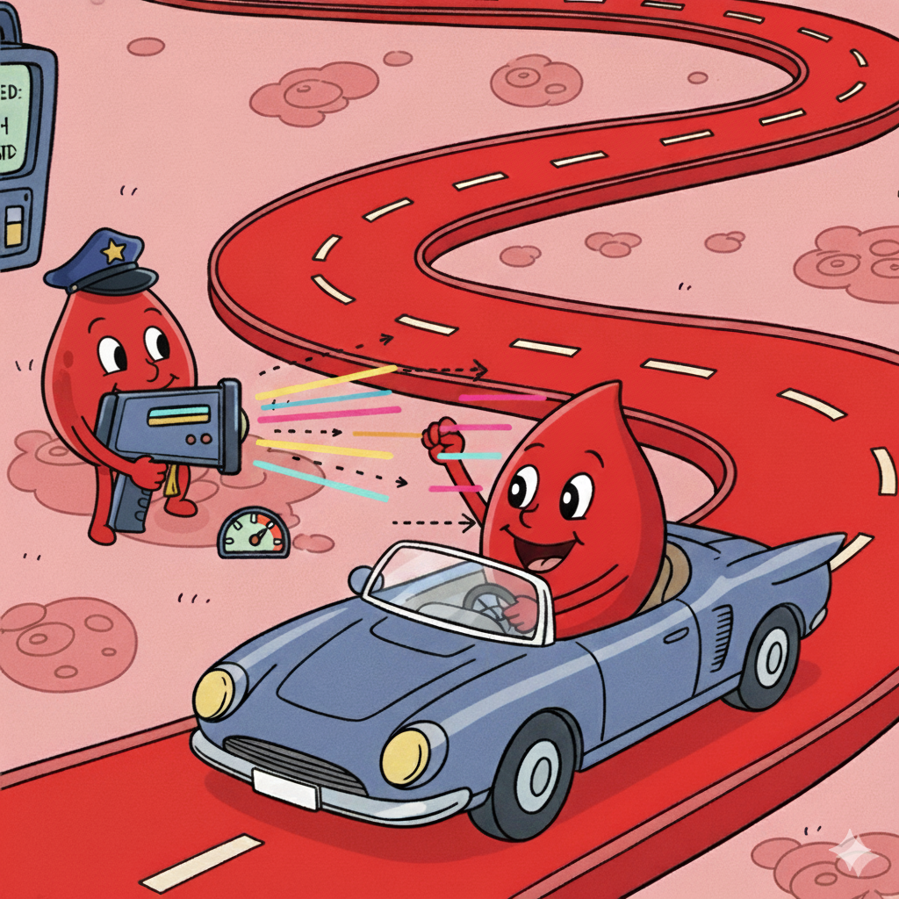

Evaluation with patient data
[Fredriksson et al., 2009]
N= 11 N= 10
Some images are AI generated
Notes:
We recruited 11 males and 10 females patients and measured the laser doppler flowmetry on the finger. The external force was direclty applied on top of the probe to properly capture the interplay between mechanics and biology. But what is LDF, just like radars for cars, the idea is to use the so-called Doppler effect to measure the red blood cell velocity, reduced flow revealing lower values and vice-versa. Notably, no significant difference was observed between men and women.

Slide 17
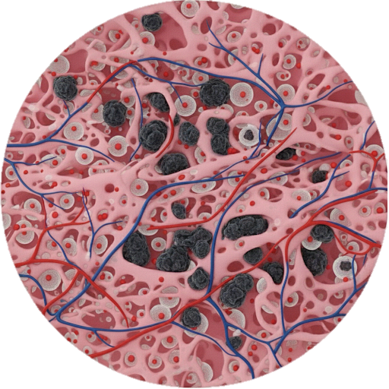
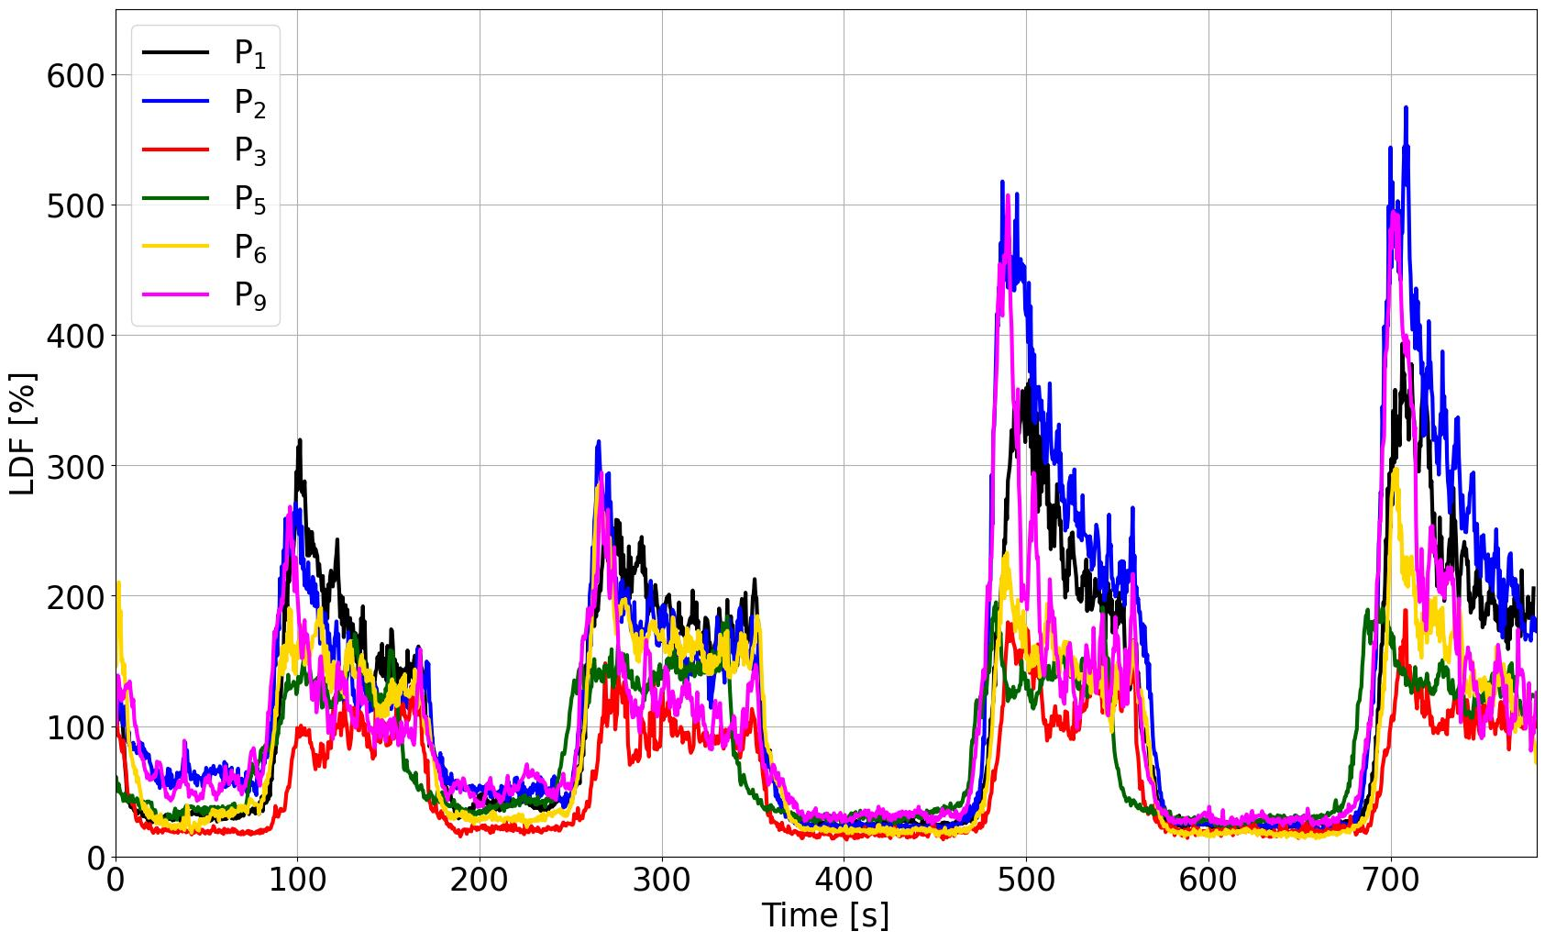
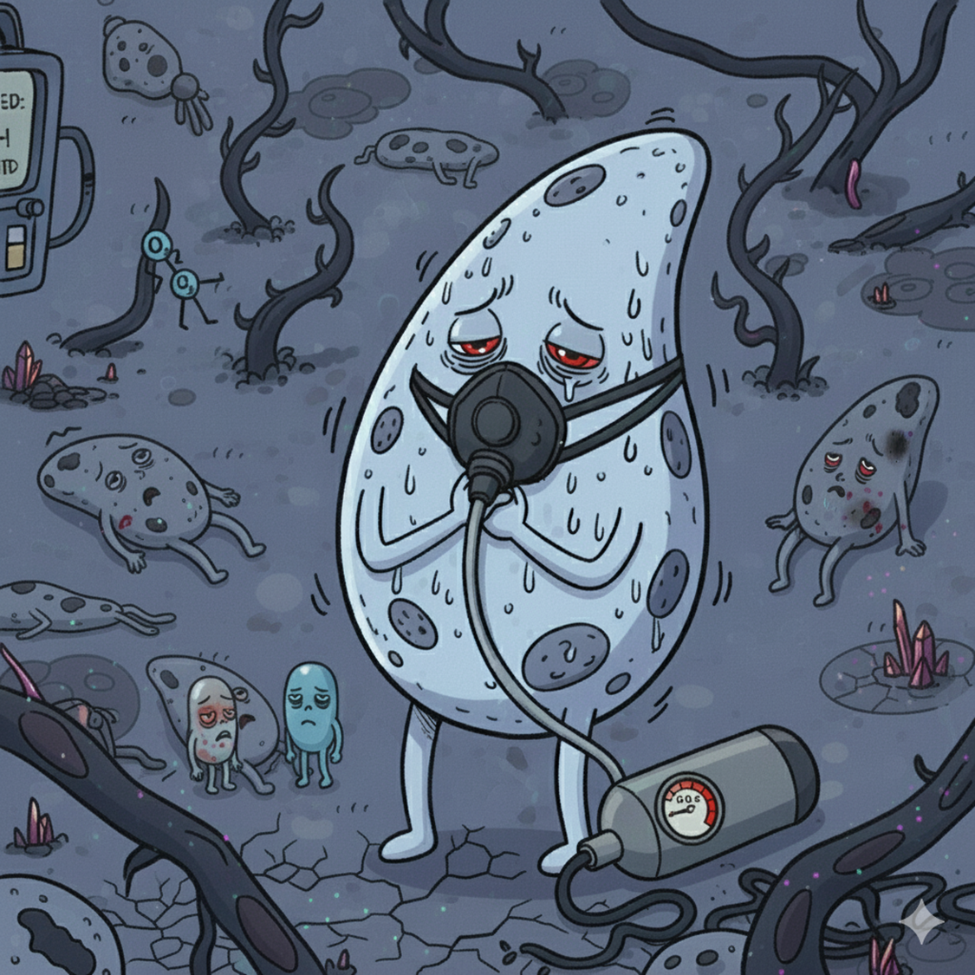
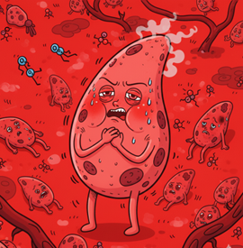
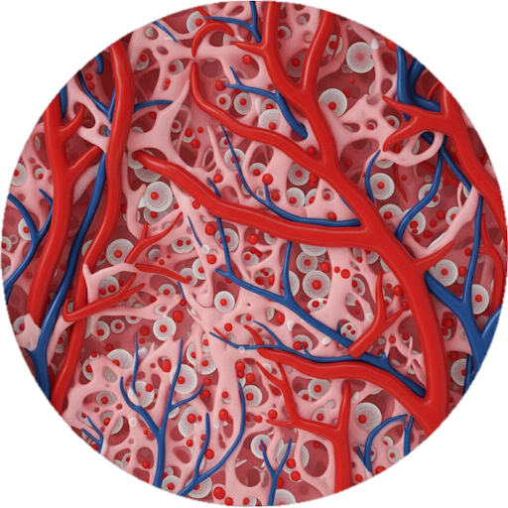
Evaluation with patient data
Ischaemia (Hypoxia)
Hyperemia (Oxydation – Water-hammer pulse)
Some images are AI generated
Notes:
Here are typical experimental curves. As we expected, we observe two different behaviors.
The first is Ischemia (Hypoxia), where applying an external load reduces the blood vessel sections
Conversely, releasing the load, we observe hyperemia which is a Water-hammer pulse

Slide 18
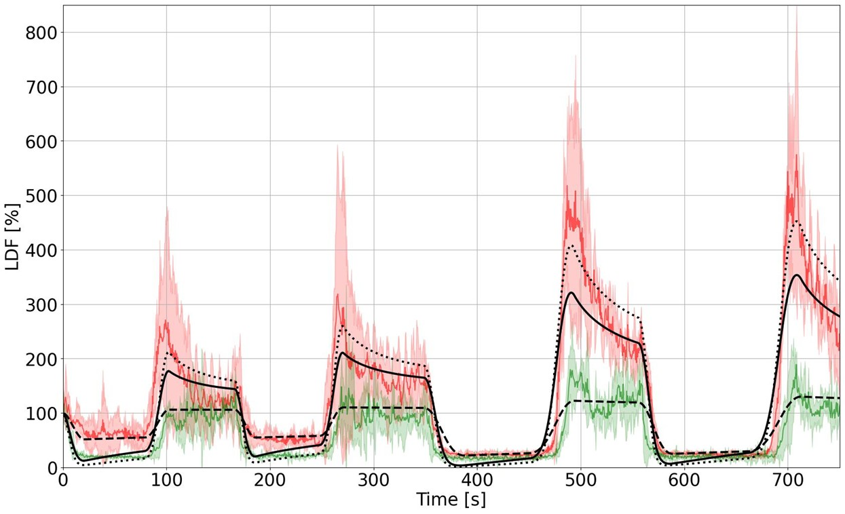
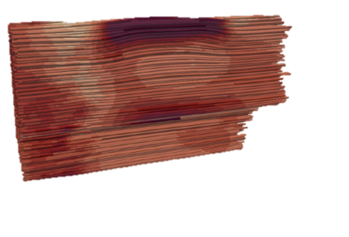
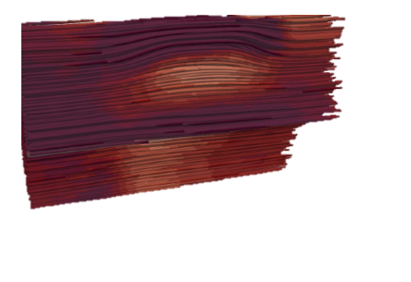

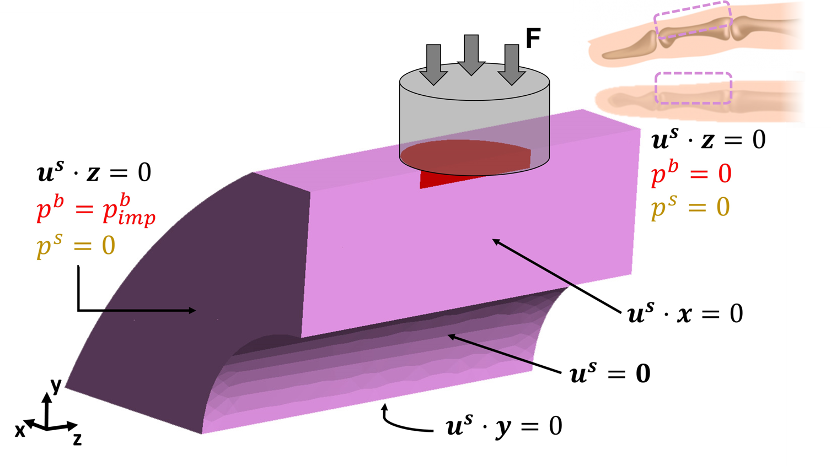
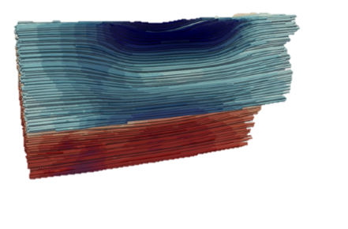
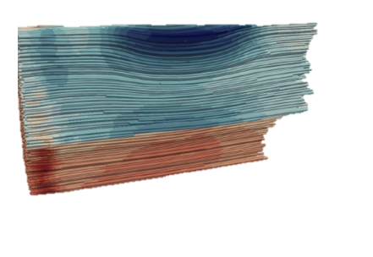
Evaluation with patient data
Notes:
Interestingly, the model was capable of representing both ischaemia and hyperemia, without any neurological considerations.

Slide 19

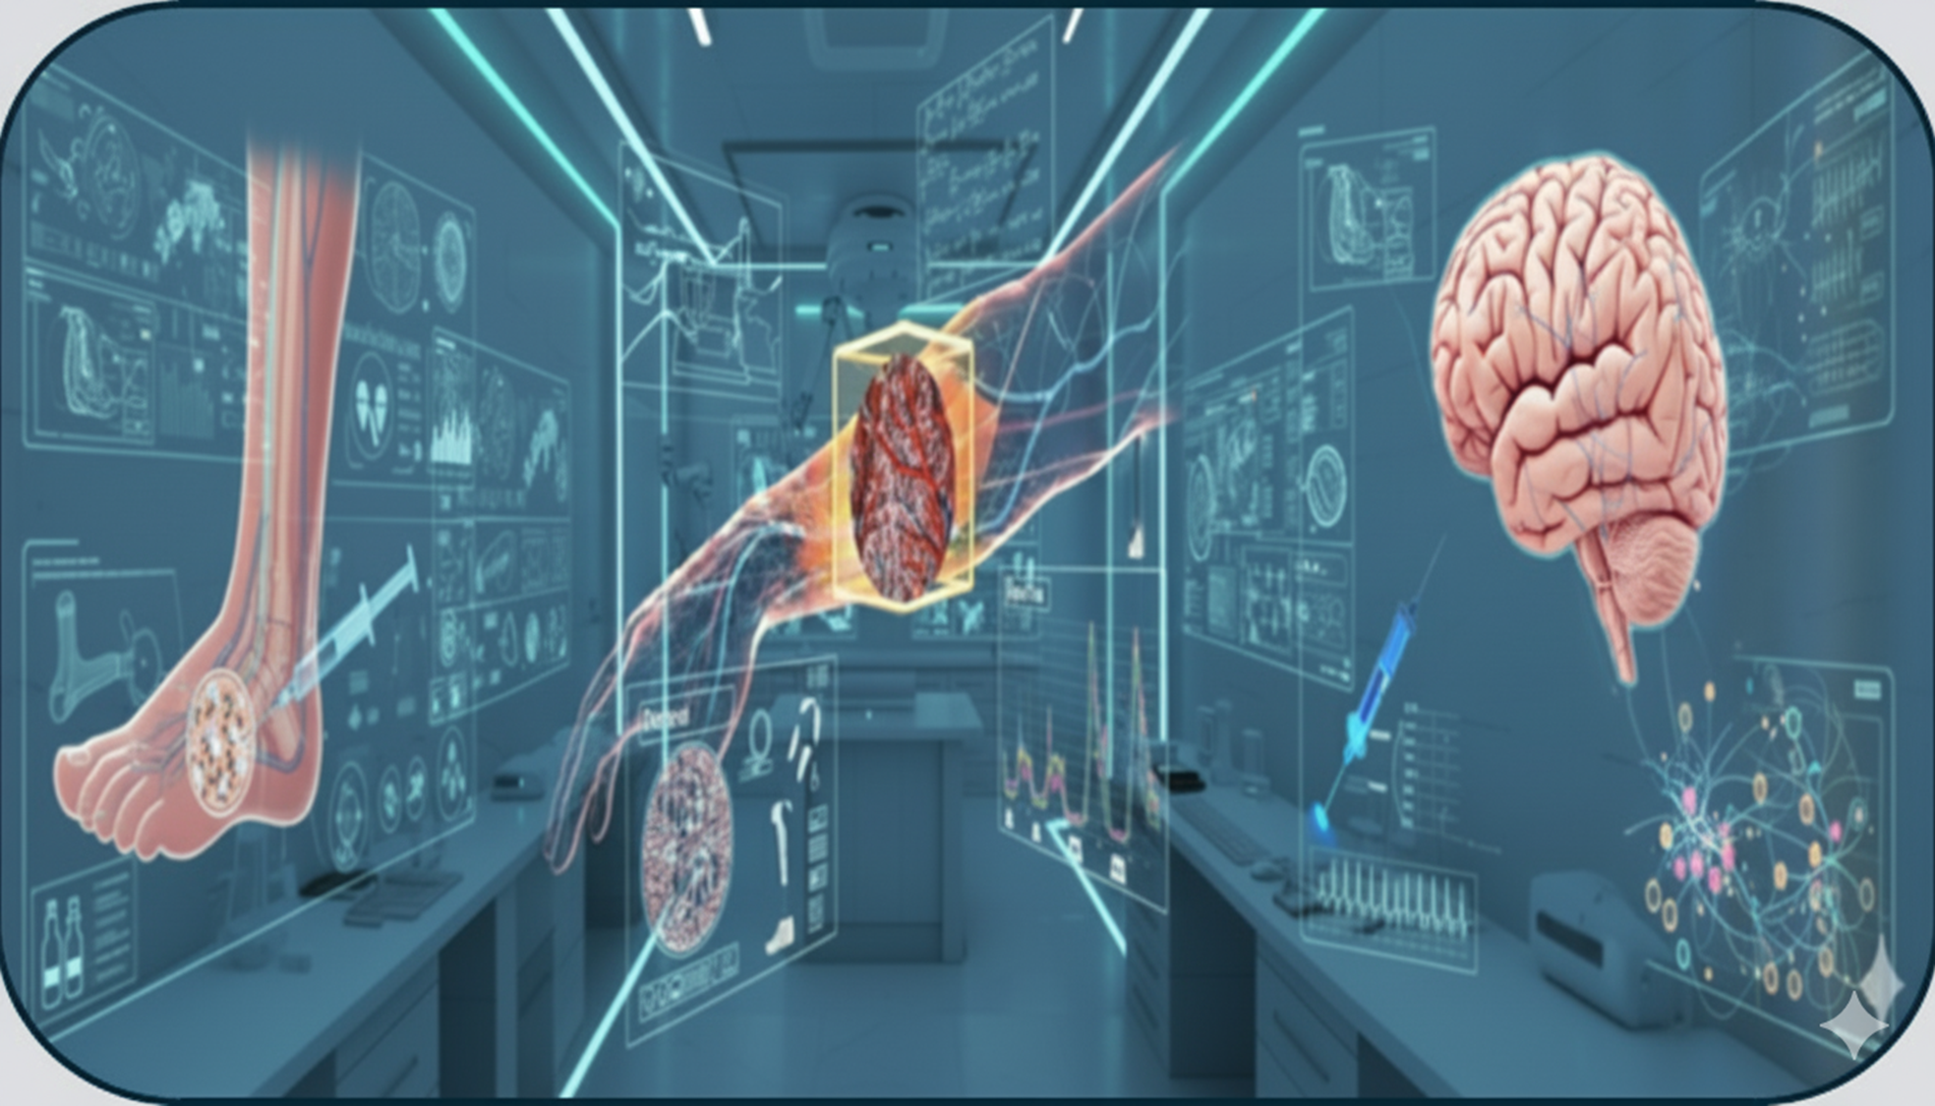
Perspectives
Highly transferable
Conservation Laws
Constitutive Laws
Mass Conservation
Solid
Solid
Cells
Oxygen
Stress-Strain law
IF
Blood
Interstitium
F(x, p^{α}) =
IF pressure / Cell Saturation
Force Equilibrium
Vascular phase
Total stress
Darcy Blood
Porosity
Permeability
Darcy IF
Darcy Cells
Oxygen
Diff. Oxygen
Abs. Oxygen
Some images are AI generated
✔ Hierarchical and Modular porous framework,
✔ Ischaemia and PORH were obtained with mechanics only,
✔ Open-source implementation,
✔ Transferable: plantar foot, brain, tissue engineering, drug delivery, ➪ Biological integration should be compared to experimental campaigns,
➪ For pressure ulcers prevention, damage and remodelling should be introduced,
Notes:
This skin porous model is a comprehensive tool for understanding the bidirectional link between mechanical integrity and microvascular health that has large fields of interest such as diabetic foot and brain.

Slide 20

Perspectives
Towards Personnalized Treatment
Conservation Laws
Constitutive Laws
Mass Conservation
Solid
Solid
Cells
Oxygen
Stress-Strain law
IF
Blood
Interstitium
F(x, p^{α}) =
IF pressure / Cell Saturation
Force Equilibrium
Vascular phase
Total stress
Darcy Blood
Porosity
Permeability
Darcy IF
Darcy Cells
Oxygen
Diff. Oxygen
Abs. Oxygen
Some images are AI generated
✔ Hierarchical and Modular porous framework,
✔ Ischaemia and PORH were obtained with mechanics only,
✔ Open-source implementation,
✔ Transferable: plantar foot, brain, tissue engineering, drug delivery, ➪ Biological integration should be compared to experimental campaigns,
➪ For pressure ulcers prevention, damage and remodelling should be introduced,
Notes:
But mainly it provides new insight towards a personalised care for PU prevention.

Slide 21








Thank you for your attention !
AFR-FNR 17013182
Notes:
Finally, I would like to express our deepest gratitude to the participants in these experiments. Without their commitment, these results could not have been achieved. We also thank everyone who contributed to this work, whose efforts we have tried to represent visually.

Slide 22

[]

